Slide 1
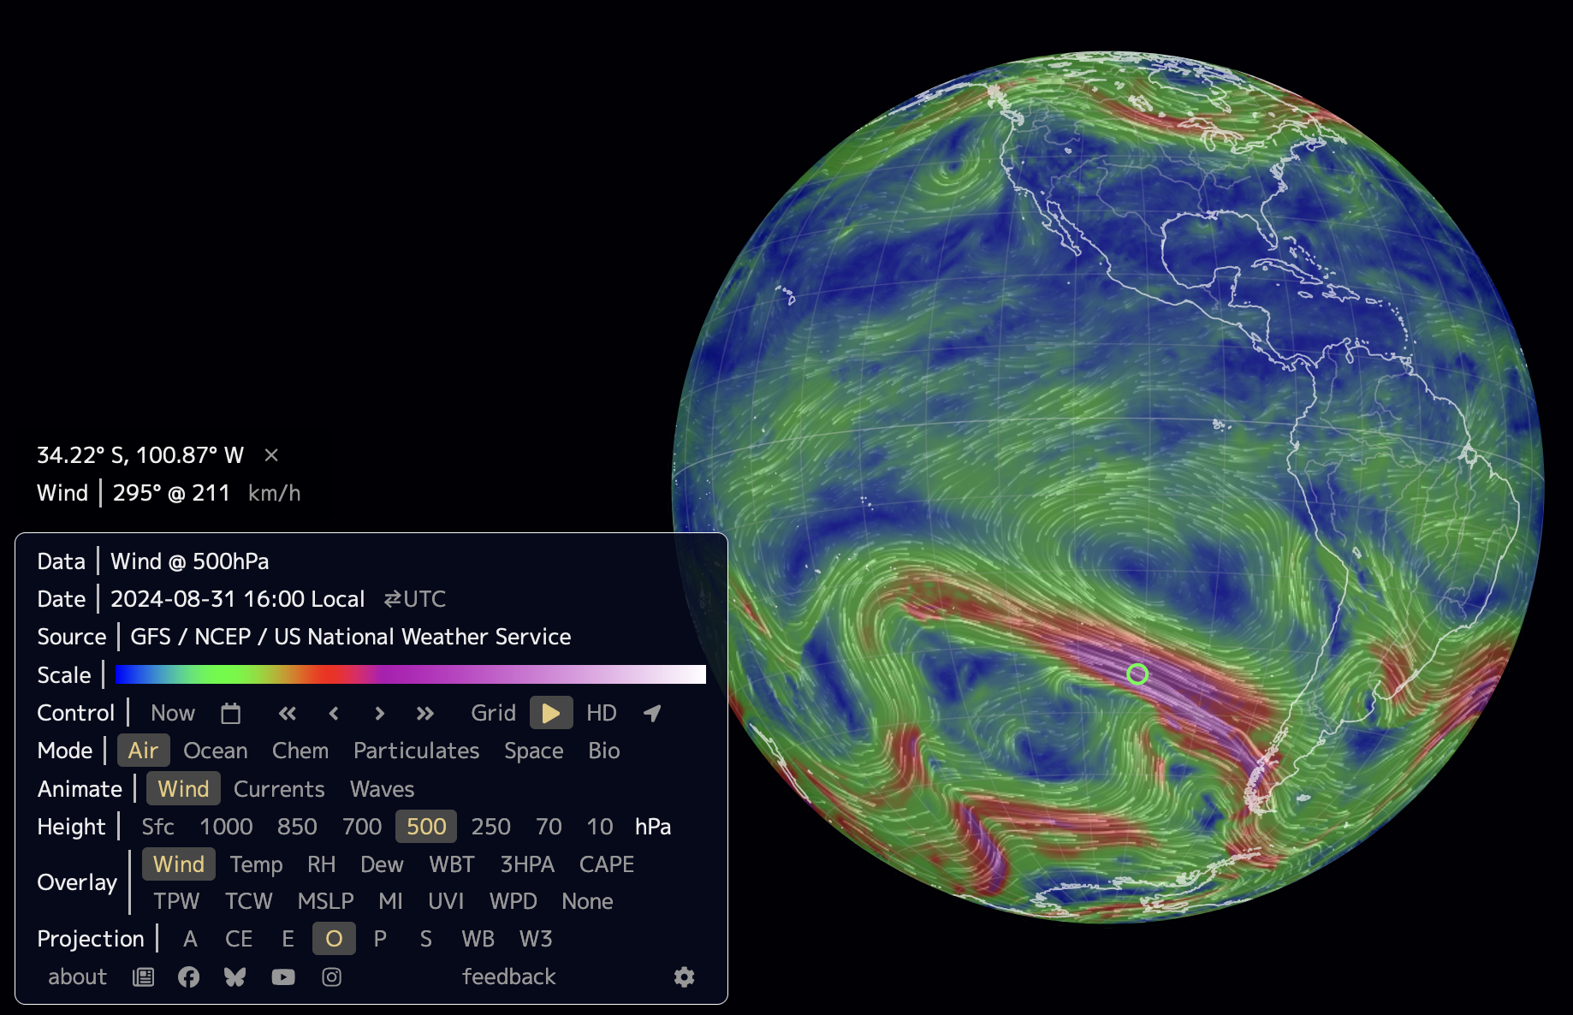
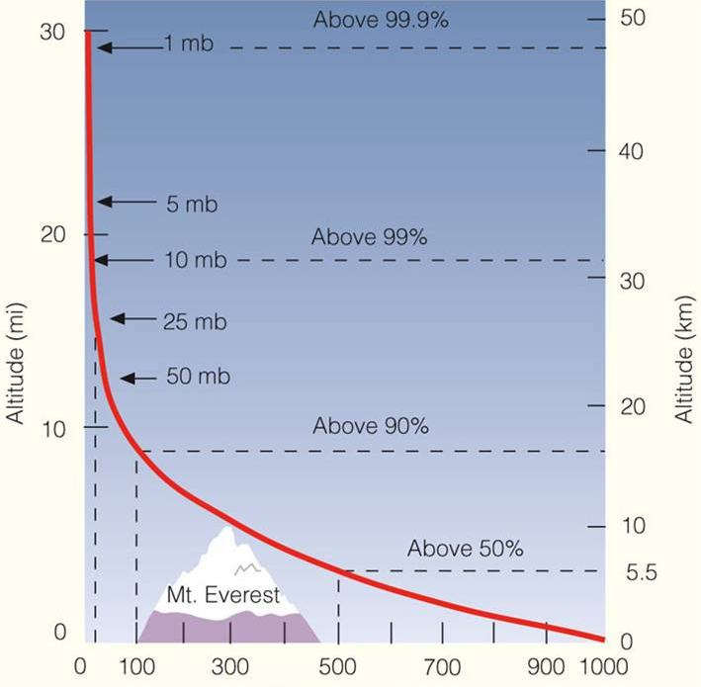
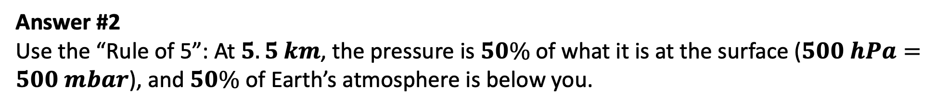

In Earth.nullschool.net, we can change the “height,” but the numbers are in pressure units …
Answer #1 Use a barometric chart.
Question: How does the pressure tell us the height?
Pressure in $hPa$ (AKA mbar)
Answer #2
Use the “Rule of 5”: At $5.5 km$, the pressure is $50\%$of what it is at the surface ($500 hPa=500 mbar$), and $50\%$ of Earth’s atmosphere is below you.

Slide 2
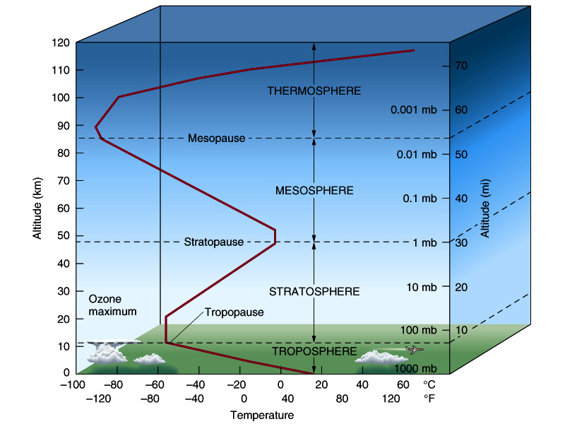
The troposphere and the stratosphere
The troposphere and the stratosphere are defined by turnarounds in the temperature.

Slide 3
The troposphere and the stratosphere
The troposphere and the stratosphere are defined by turnarounds in the temperature.
The troposphere is where most of the weather and climate takes place.

Slide 4
The troposphere and the stratosphere
The troposphere and the stratosphere are defined by turnarounds in the temperature.
The troposphere is where most of the weather and climate takes place.
Just below the top of the stratosphere is the ozone layer.

Slide 5
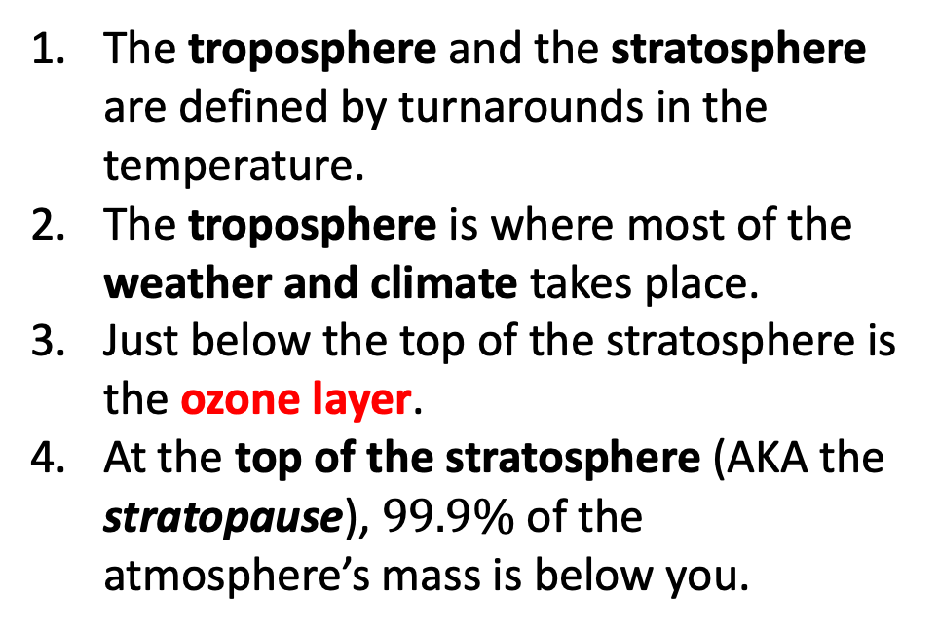
The troposphere and the stratosphere
The troposphere and the stratosphere are defined by turnarounds in the temperature.
The troposphere is where most of the weather and climate takes place.
Just below the top of the stratosphere is the ozone layer.
At the top of the stratosphere (AKA the stratopause), $99.9\%$ of the atmosphere’s mass is below you.

Slide 6
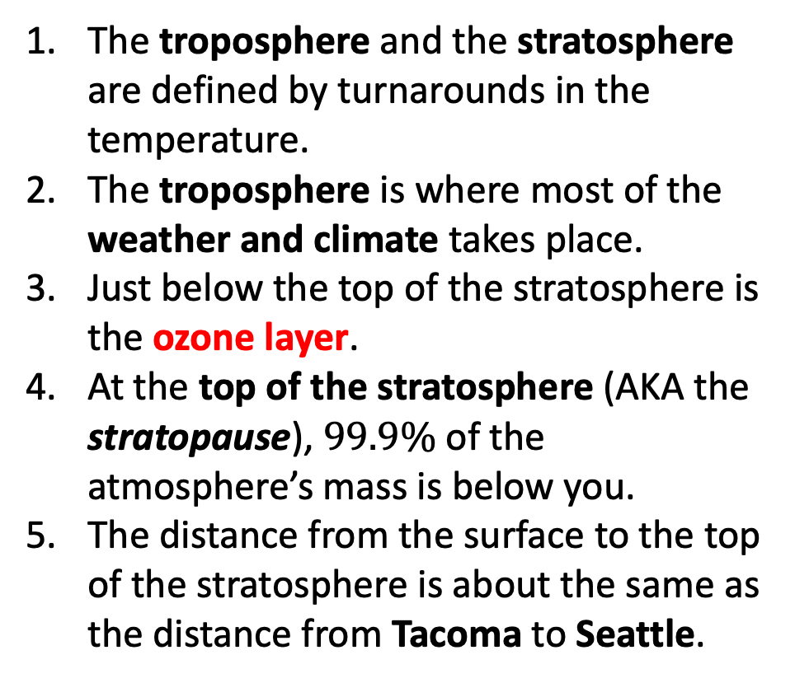
The troposphere and the stratosphere
The troposphere and the stratosphere are defined by turnarounds in the temperature.
The troposphere is where most of the weather and climate takes place.
Just below the top of the stratosphere is the ozone layer.
At the top of the stratosphere (AKA the stratopause), $99.9\%$ of the atmosphere’s mass is below you.
The distance from the surface to the top of the stratosphere is about the same as the distance from Tacoma to Seattle.
Tacoma
Seattle

